Slide 1

Digital Image Processing
Unit-2: Image Enhancement in Spatial Domain
Dr. Piyush Joshi
Indian Institute of Information Technology
Sri City, Andhra Pradesh

Slide 2


Slide 3
Image Enhancement in Spatial Domain
Histogram Matching: Example

Slide 4
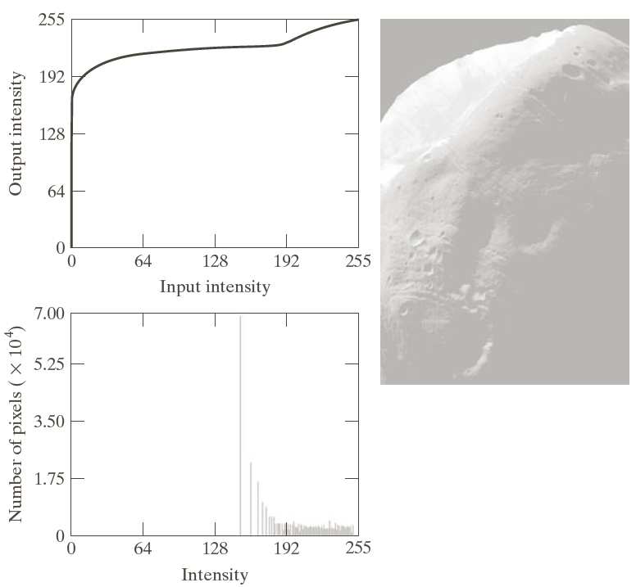
Image Enhancement in Spatial Domain
Histogram Matching: Example

Slide 6
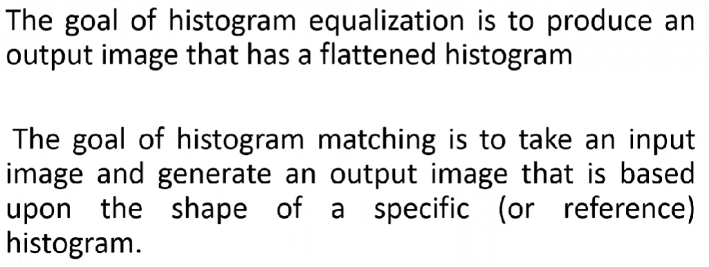
Histogram Matching (Histogram Specification)

Slide 7
Image Enhancement in Spatial Domain
Histogram Matching: Going as close as possible to target histogram

Slide 8
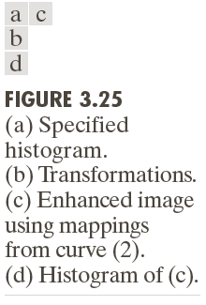
Image Enhancement in Spatial Domain
Histogram Matching: Example

Slide 9
Image Enhancement in Spatial Domain
Histogram Matching (Histogram Specification)
Generate a processed image that has a specified histogram

Slide 10
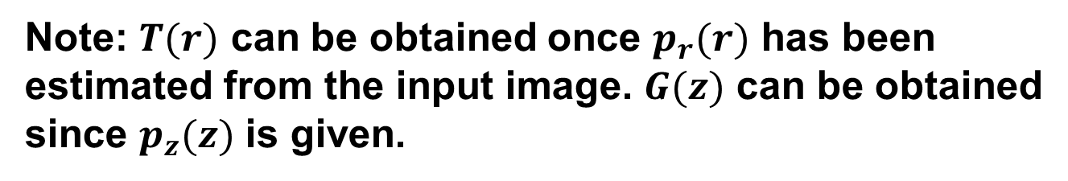
Image Enhancement in Spatial Domain
Histogram Matching (Histogram Specification)
Note: $T(r)$ can be obtained once $p_{r}(r)$ has been
estimated from the input image. $G(z)$ can be obtained
since $p_{z}(z)$ is given.

Slide 11
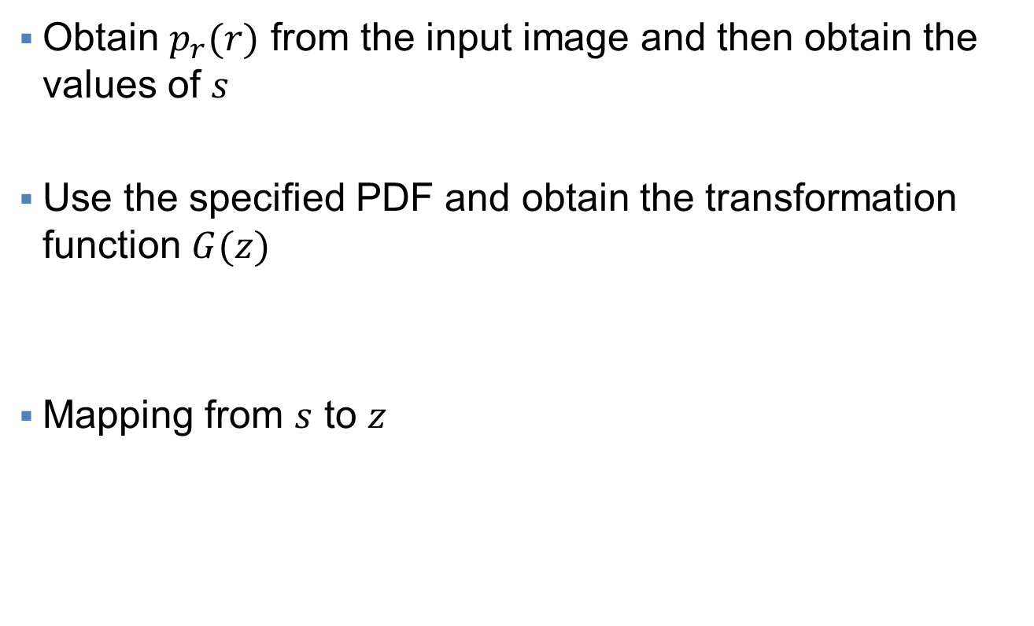
Image Enhancement in Spatial Domain
Histogram Matching: Procedure
Obtain $p_{r}(r)$ from the input image and then obtain the values of $s$
Use the specified PDF and obtain the transformation function $G(z)$
Mapping from $s$ to $z$

Slide 12
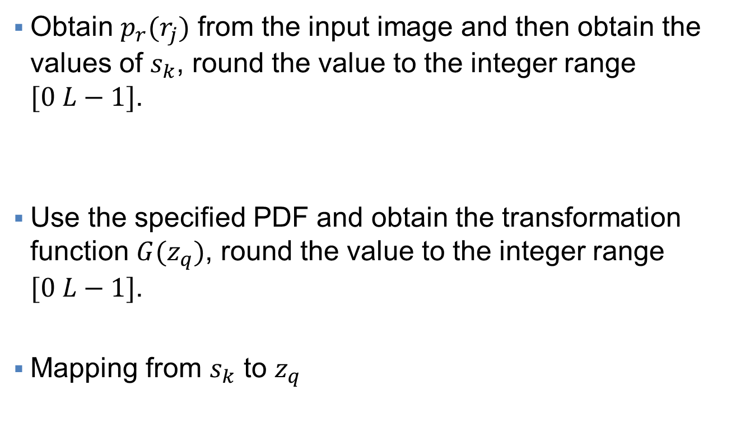
Image Enhancement in Spatial Domain
Histogram Matching: Discrete Case
Obtain $p_{r}(r_{j})$ from the input image and then obtain the values of $s_{k}$, round the value to the integer range $[0 L−1]$.
Use the specified PDF and obtain the transformation function $G(z_{q})$, round the value to the integer range $[0 L−1]$.
Mapping from $s_{k}$ to $z_{q}$

Slide 14
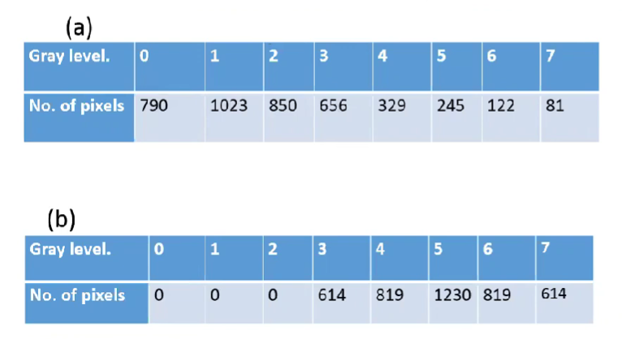
Example

Slide 15
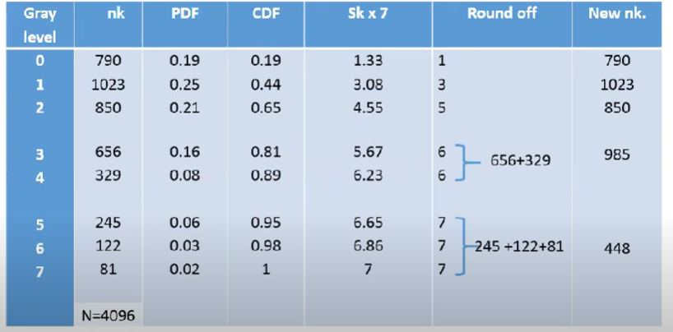
Example: HE1

Slide 16
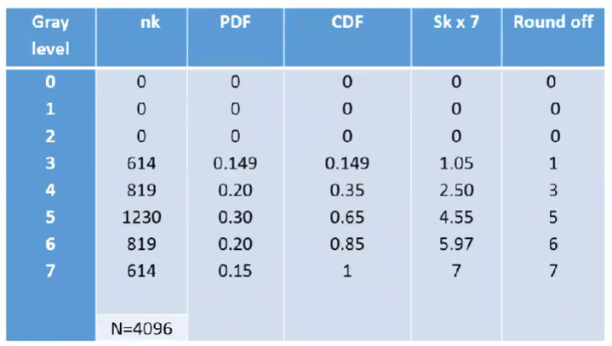
Example: HE2

Slide 19
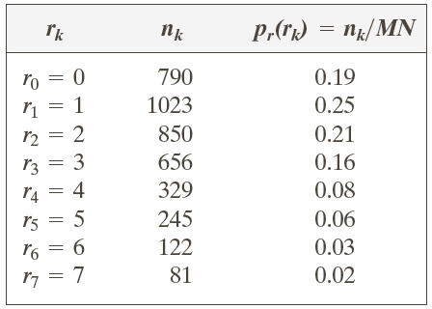
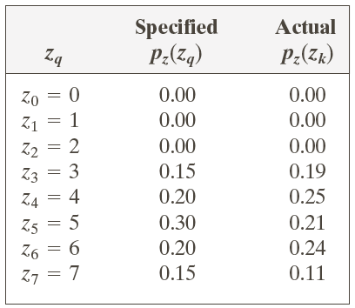
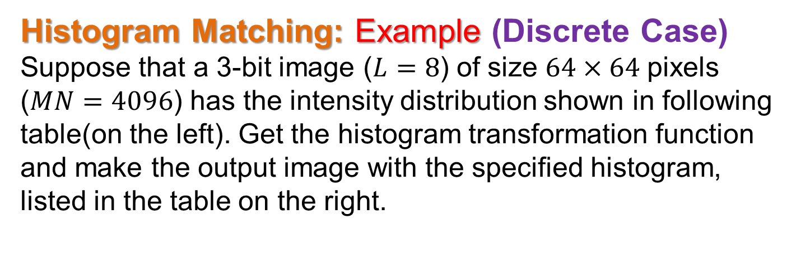
Image Enhancement in Spatial Domain
Histogram Matching: Example (Discrete Case)
Suppose that a 3-bit image ($L=8$) of size $64×64$ pixels ($MN=4096$) has the intensity distribution shown in following table(on the left). Get the histogram transformation function and make the output image with the specified histogram, listed in the table on the right.

Slide 20
Image Enhancement in Spatial Domain
Histogram Matching: Example (Discrete Case)
Obtain the scaled histogram-equalized values,
Compute all the values of the transformation
function G,

Slide 21
Image Enhancement in Spatial Domain
Histogram Matching: Example (Discrete Case)

Slide 22
Image Enhancement in Spatial Domain
Histogram Matching: Example (Discrete Case)
Obtain the scaled histogram-equalized values,
Compute all the values of the transformation function G,
s₀
s₁
s₂
s₃
s₄
s₅
s₆
s₇

Slide 23
Image Enhancement in Spatial Domain
Histogram Matching: Example (Discrete Case)

Slide 24
Image Enhancement in Spatial Domain
Histogram Matching: Example (Discrete Case)

Slide 25
Image Enhancement in Spatial Domain
Histogram Matching: Example

Slide 26
Image Enhancement in Spatial Domain
Histogram Matching: Example

Slide 27
Image Enhancement in Spatial Domain
Histogram Matching: Example

Slide 28
Image Enhancement in Spatial Domain
Local Histogram Processing
Define a neighborhood and move its center from pixel to pixel.
At each location, the histogram of the points in the neighborhood is computed. Either histogram equalization or histogram specification transformation function is obtained.
Map the intensity of the pixel centered in the neighborhood.
Move to the next location and repeat the procedure.

Slide 29
Image Enhancement in Spatial Domain
Local Histogram Processing

Slide 30
Image Enhancement in Spatial Domain
Histogram Statistics for Image Enhancement
Average Intensity
Nth moment of mean
Variance

Slide 31
Image Enhancement in Spatial Domain
Histogram Statistics for Image Enhancement

Slide 32
Image Enhancement in Spatial Domain
Histogram Statistics for Image Enhancement

Slide 33
Image Enhancement in Spatial Domain
Spatial Filtering
The process of linear filtering is called convolution.
The filter masks are sometimes called convolution masks or convolution kernel.

Slide 34
Image Enhancement in Spatial Domain
Smoothing Spatial Filters
Smoothing filters are used for blurring and for noise reduction.
Blurring is used in removal of small details and bridging of small gaps in lines or curves.
Smoothing spatial filters include linear filters and nonlinear filters.
These filters sometimes are called averaging filters.
They are also referred to a lowpass filters in frequency domain.

Slide 35
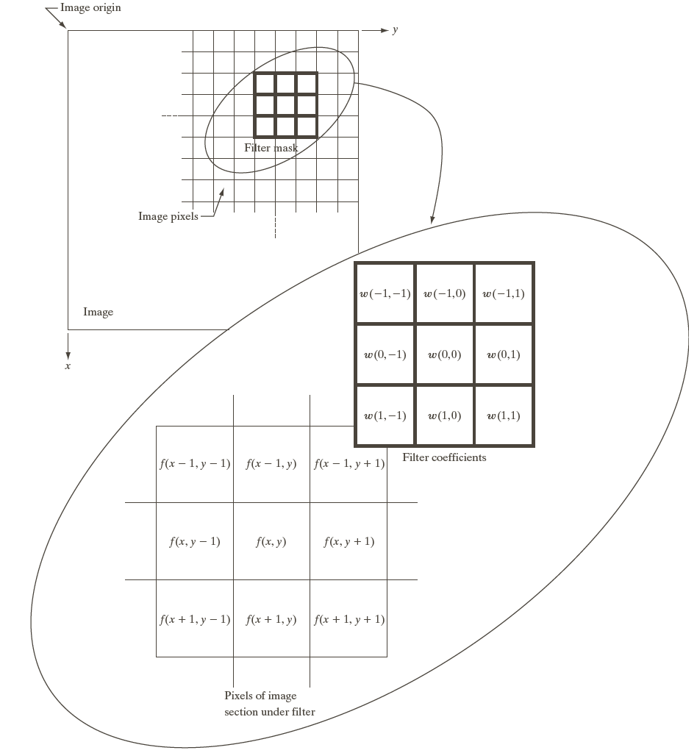
Spatial Filtering

Slide 36
Image Enhancement in Spatial Domain
Smoothing Linear Spatial Filters

Slide 37
Image Enhancement in Spatial Domain
Two Smoothing Averaging Filter Masks
average
weighted average

Slide 38
Two Smoothing Averaging Filter Masks

Slide 39
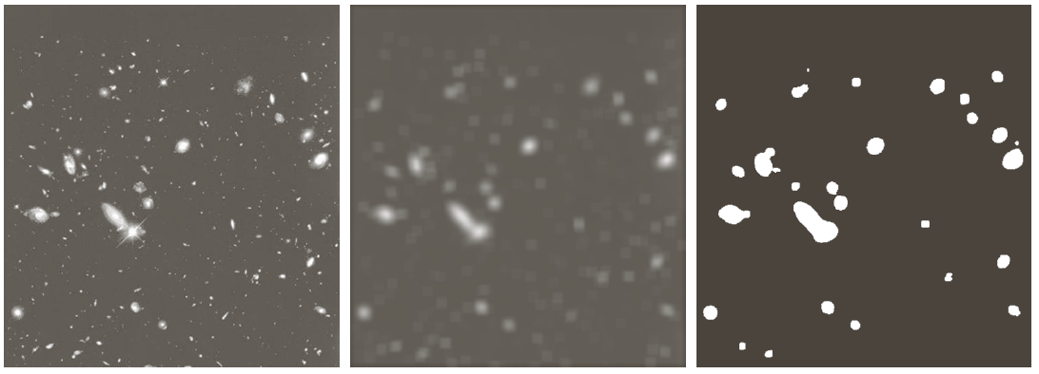
Image Enhancement in Spatial Domain
Example: Gross Representation of Objects

Slide 40
Image Enhancement in Spatial Domain
Order-Statistic (Nonlinear) Filters
Nonlinear
Based on ordering (ranking) the pixels contained in the filter mask
Replacing the value of the center pixel with the value determined by the ranking result
E.g., median filter, max filter, min filter

Slide 41
Image Enhancement in Spatial Domain
Example: Use of Median Filtering for Noise Reduction

Slide 42
Image Enhancement in Spatial Domain
Sharpening Spatial Filters
Foundation
Laplacian Operator
Unsharp Masking and Highboost Filtering
Using First-Order Derivatives for Nonlinear Image Sharpening — The Gradient

Slide 43
Image Enhancement in Spatial Domain
Sharpening Spatial Filters: Foundation
The first-order derivative of a one-dimensional function f(x) is the difference
The second-order derivative of f(x) as the difference

Slide 45
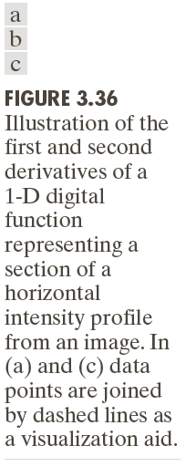

Slide 46
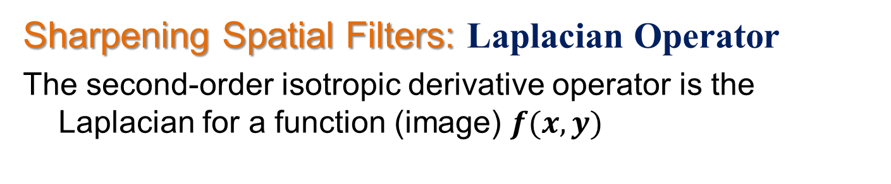
Image Enhancement in Spatial Domain
Sharpening Spatial Filters: Laplacian Operator
The second-order isotropic derivative operator is the Laplacian for a function (image) $f(x,y)$

Slide 47
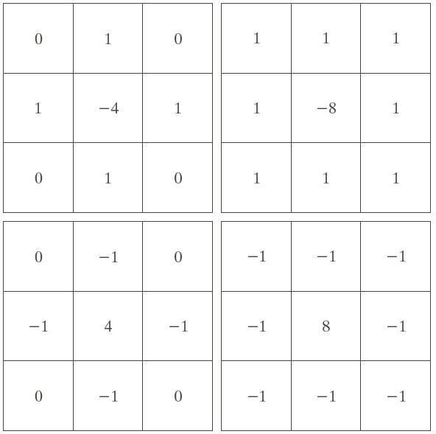
Image Enhancement in Spatial Domain
Sharpening Spatial Filters: Laplacian Operator

Slide 48
Image Enhancement in Spatial Domain
Sharpening Spatial Filters: Laplacian Operator
Image sharpening in the way of using the Laplacian:

Slide 49
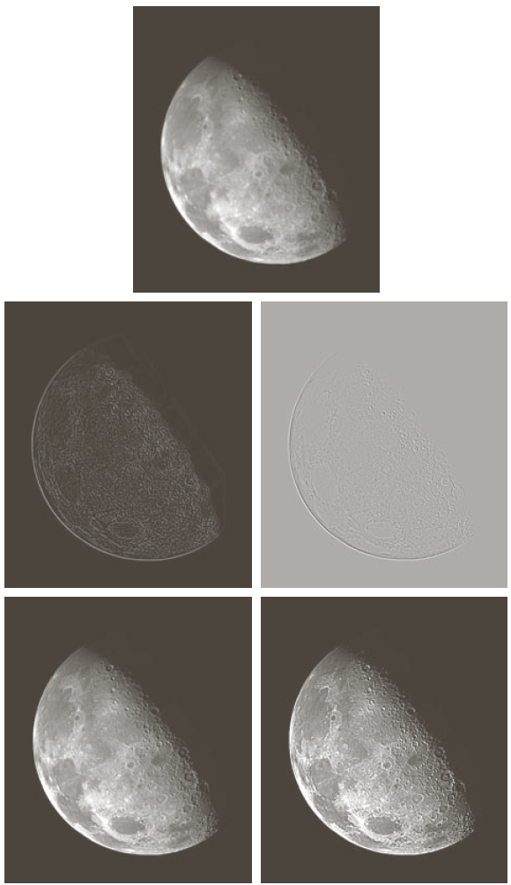

Slide 50
Image Enhancement in Spatial Domain
Image Sharpening based on First-Order Derivatives
Gradient Image

Slide 51
Image Enhancement in Spatial Domain
Image Sharpening based on First-Order Derivatives
z₁ | Z₂ | z₃
z₄ | Z₅ | z₆
z₇ | z₈ | z₉

Slide 52
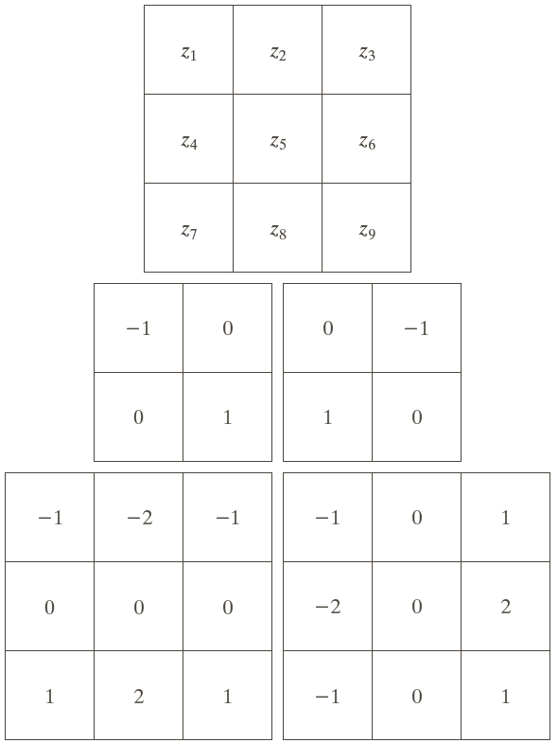
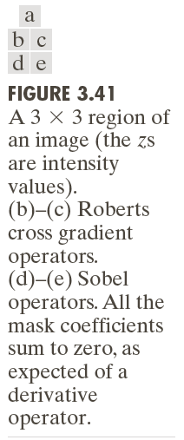
Image Sharpening based on First-Order Derivatives

Slide 53
Example
Combining
Spatial
Enhancement
Methods Goal: Enhance the
image by
sharpening it
and by bringing
out more of
the skeletal detail

